Slide 1
QHY174 Tips and Tricks
General Issues, Advice, Best Practices
2020-07-26
Notes:
Ok so this presentation is basically an accumulation of general advice, tips and best practices for using the QHY174 camera with SharpCap. It is largely gleaned from a Zoom meeting for users of the camera that George Viscome organized back in June, and which he then edited and made available to us -- thanks George. I believe that video is still available -- is that correct George?

Slide 2
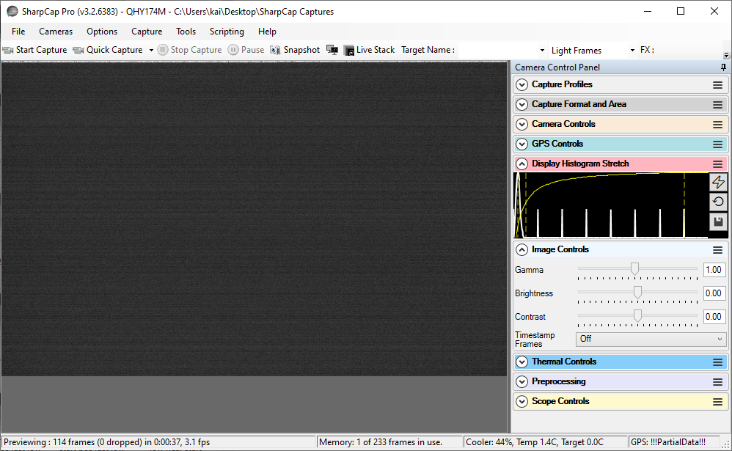
Notes:
So, let’s start with some GUI issues in SharpCap. One problem that some folks have had is not realizing which controls affect just the display on screen, vs which modify the actual captured data itself as well. In particular, I’m talking about Display Histogram Stretch vs Image Controls. Both will alter the display of an image...

Slide 3
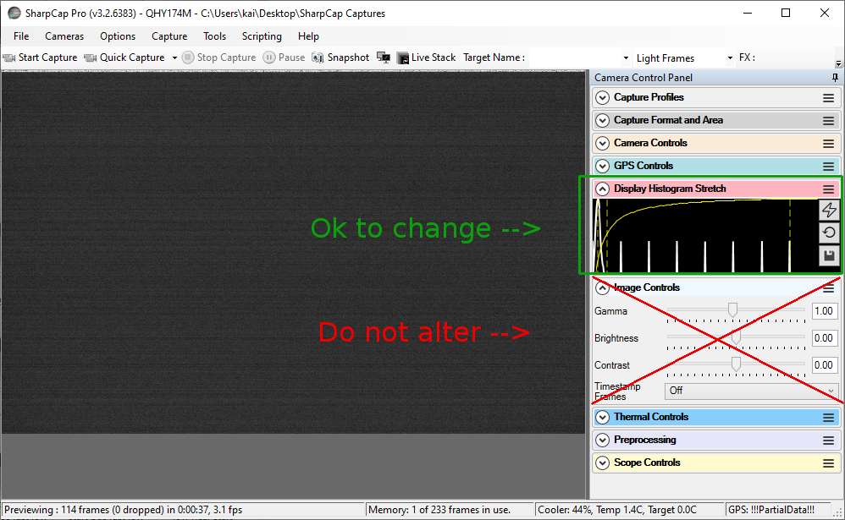
Notes:
..but Image Controls will do it by permanently altering the data itself. So we don’t want to change the Image Controls from their default values of Gamma 1, Brightness 0, Contrast 0, Timestamp off. If you need to enhance what you see in the field, use the Display Histogram Stretch: no matter what you do with this, it will not alter the data captured.

Slide 4
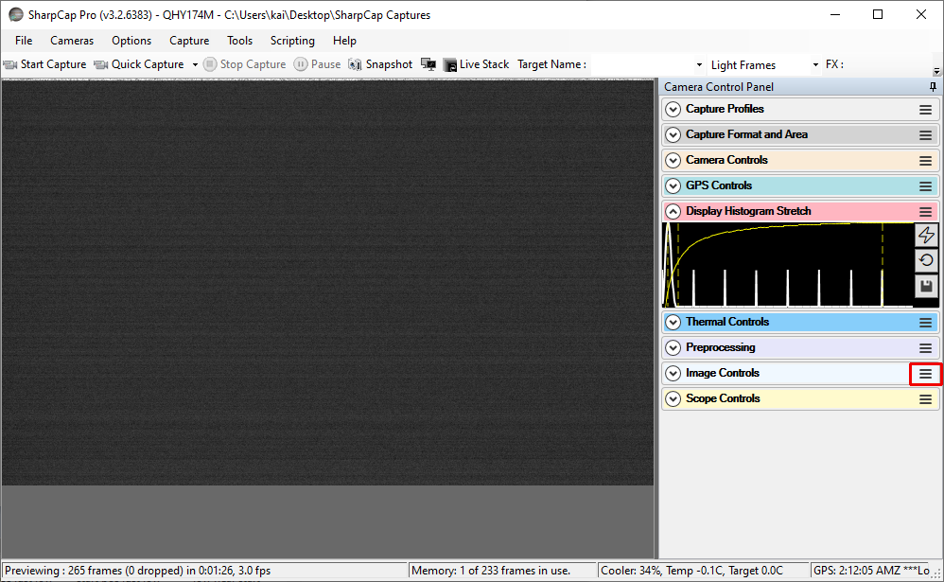
Notes:
As an aid to help remember not to alter Image Controls, I slide it to the bottom of the stack of controls, as you see here, along with Preprocessing and Scope Controls, which I also never use. You can slide a control in SharpCap by grabbing it by the 3-line “hamburger” control on the right and sliding it. Useful when there’s limited vertical space to expand the controls you are using.

Slide 5
Binning
Marc Buie / SwRI use 1x1
More will not improve S/N with CMOS as it may with CCD
Thus any target visible in 2x2 binning should be visible in 1x1 in post-analysis
So binning can be done in analysis, but cannot be undone -- so why lose an option by binning
Binning risks running out of dynamic range (but this should be tested)
Maybe bin if way oversampling (bad seeing), to get FWHM back to 2-3 pixels
Notes:
Next up: binning. Marc Buie uses 1x1, and he’s had lots of experience with the QHY from the New Horizons and Lucy occultation campaigns. More binning will not improve the signal-to-noise ratio with CMOS chips like the QHY uses, unlike with CCD where it may reduce the fraction of read noise. Thus, any target visible in 2x2 binning should also be visible in 1x1, if we scale up later in analysis. So binning can be done in analysis if desired, but not undone -- so why limit your options by binning. Also, binning risks running out of dynamic range, though this needs to be tested to see where the limits lie -- is the binning done in 12 bits where the A-to-D converter lives? Or 16 bits once those values are mapped? We could maybe bin if we’re already way oversampling, e.g. the seeing is poor so stars’ images are really wide, binning might still leave the FWHM up at 2-3 pixels.

Slide 6
FITS vs SER
FITS:
Single frame per file can be easier to transfer, view, edit, analyze
Preferred format for some organizations we may forward data to, e.g. SwRI
Saves more GPS data, e.g. lat, lon, end of exposure
SER:
Not opening many files during capture may allow faster capture rate
Stores all frames’ timestamps at end of file, so disk-full during capture may risk loss of all timestamps?
Notes:
FITS vs SER format: which to save in? A lot of folks like FITS, though both formats can be used. Advantages to FITS include ease of transfer, viewing, editing and analysis for some, because the data is already split into one frame per file. FITS is also the preferred format for some folks we might forward our data to, like SwRI. And I believe it saves more GPS data, like latitude, longitude, start and end of exposure. SER, by only using one file, can sometimes enable higher frame rates that FITS’ opening of many files. But one potential downside is that it stores all the frames’ timestamps at the very end of the file, so a disk full during a capture may risk the loss of all timestamp info.

Slide 7
Laptop-related hardware issues
Disk speed is most important issue for capture speed: use SSD if possible
USB 3 if available
Try different cables: not all USB 3 cables created equal
Be wary of long cables: potential to lose bandwidth
Notes:
So, some laptop hardware issues. Disk speed is probably the most important issue governing capture speed, so use solid-state disks if possible. Also use USB 3 ports if available, over USB 2. Try different cables: it seems from experience not all USB 3 cables are created equal, some can even fail to connect to the camera. Be wary of long cables: they can have increased potential to lose bandwidth.

Slide 8
Other hardware issues
Always connect 12V cooler power
Runs TEC and fan, probably dew heater too
Cooled chip vastly reduces hot pixels which can ruin data
Always connect at camera start: minimizes thermal shock
Cooler temp fluctuations may have been addressed in SharpCap 3.2.5936?
Reseat GPS antenna connection if BadData: could be loose
Secure cables on scope with rubber bands/Velcro
Treat camera nicely
If cold outside, put in ziploc bag first to prevent condensation when indoors
Bring its temp up gradually when bringing inside: leave in garage for awhile if cold
If dewy, do not put away wet; let dry outside box
Notes:
Some other hardware notes. Always connect the 12V cooler power. It just runs the thermoelectric cooler and fan, probably the dew heater too. So technically it doesn’t affect being able to get an image from the camera. But there are a number of reasons to use it. First, a cooled chip vastly reduces hot pixels, which can ruin image data. Always connect it at camera start, to minimize thermal shock: this way the cooler only has to reduce from ambient, not a preheated camera that’s been running awhile already. And cooler temp fluctuations that some have noticed in earlier versions of SharpCap may have been addressed in 3.2.5936: I noticed an `improved QHY cooling’ note for that version, though I didn’t get details. Re-seat the GPS antenna connector if BadData is seen: it could be loose. (But also see my earlier presentation for other causes of BadData.) Secure cables with rubber bands or velcro, to reduce stress on connectors and minimize chances of losing a connection.
Treat the camera nicely: if it was used when cold outside, put in ziploc bag before bringing indoors, to prevent condensation. Maybe leave it in the garage for awhile to acclimate slowly. If it’s already dewy, do not put it away wet: leave outside the box to dry off

Slide 9
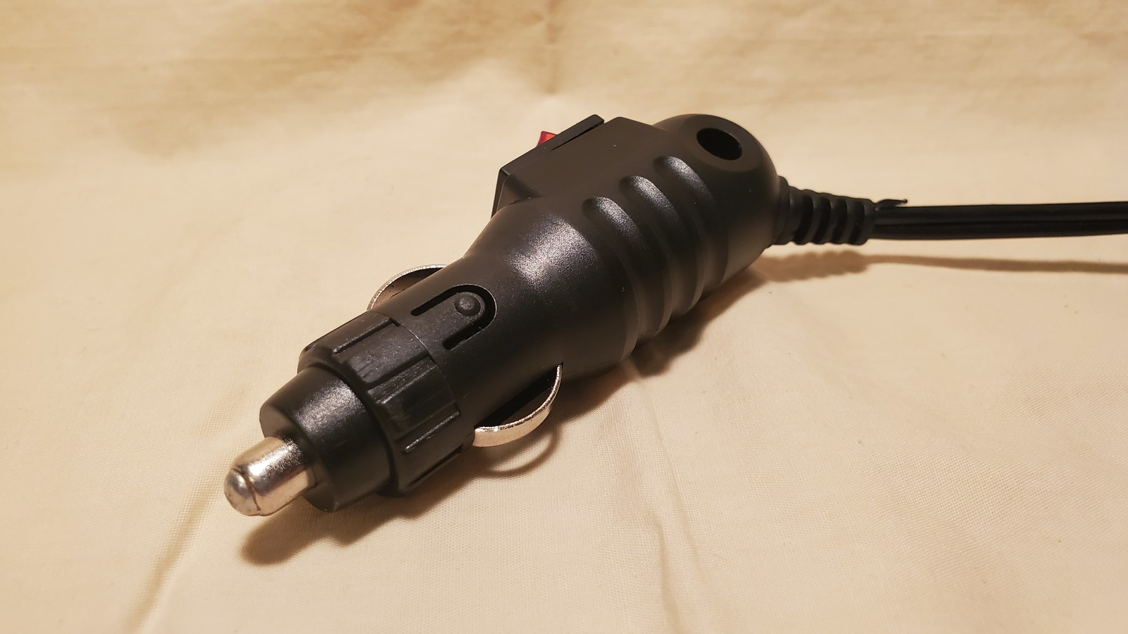
Notes:
Another hardware note: the 12V cooler cigarette plugs for these cameras are notorious for having intermittent connections to the socket, even when pushed in firmly, because the metal tip is just a millimeter or so short of ideal. So I just added a blob of solder to the metal tip...

Slide 10
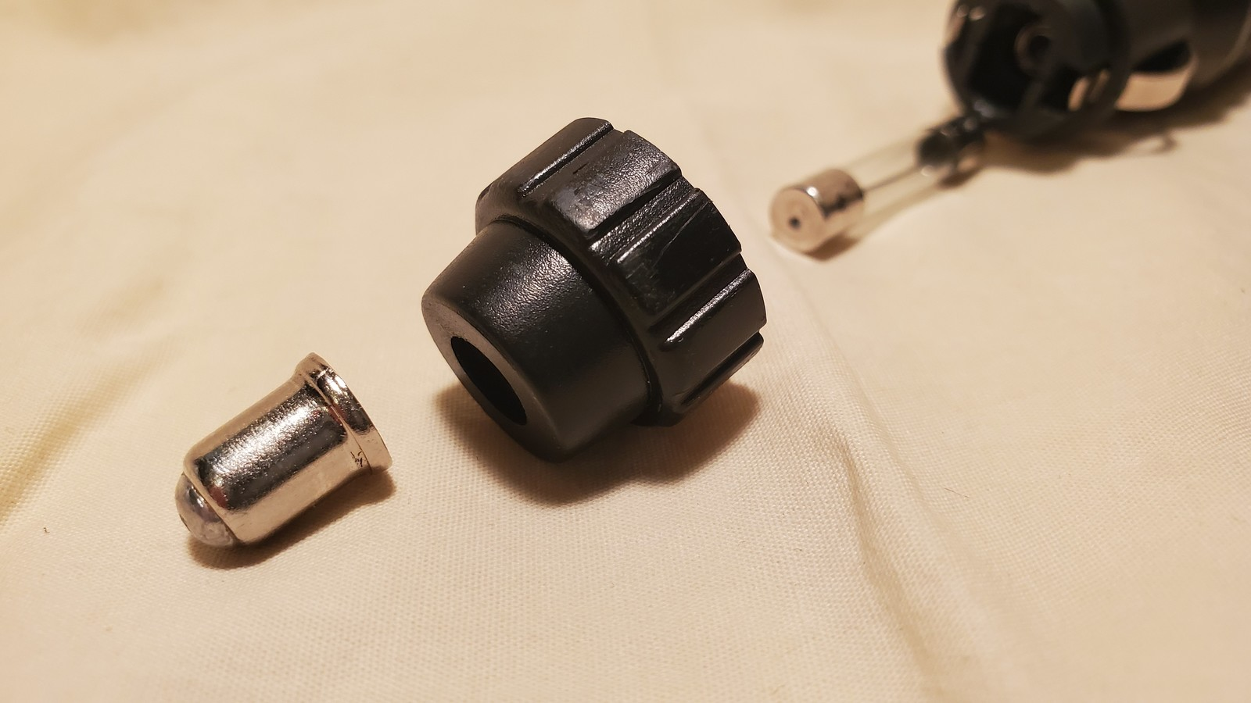
Notes:
...they come apart easily by unscrewing the plastic collar, so you can solder without melting the plug. Since doing this I haven’t had the plug break connection once.

Slide 11
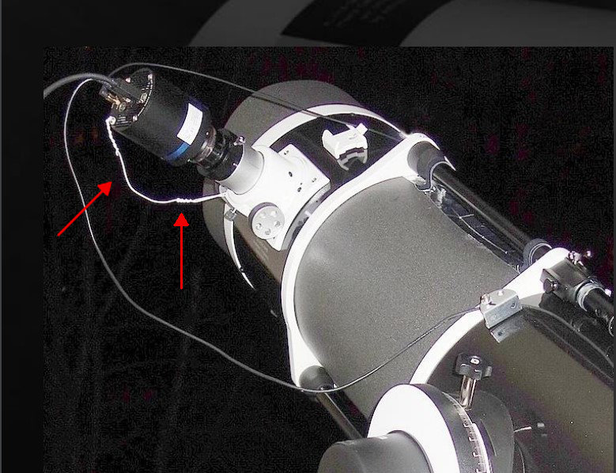
Image credit: Christian Weber
Notes:
These cameras are round, slickery, and expensive, and often attached to our scopes with nothing more than a single tiny set screw -- just inviting them to be dropped, as some have found out. Making a tether was suggested, and I found this picture of Christian Weber’s setup, where he has apparently simply attached a bit of wire under one of the camera screws, and attached the other end to a hardpoint on the scope.

Slide 12
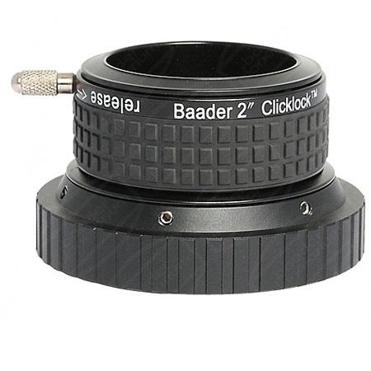
Image credit: Adorama/Baader Planetarium
Notes:
Another useful tool some have used are the Baader Planetarium ClickLock eyepiece holders. With a simple twist, they can secure eyepieces -- and heavy cameras that have eyepiece noses like the QHY -- much better than the typical set screw’s single point of contact. I also imagine that large ring is easier to twist in the cold than a tiny screw. Getting one of these is definitely on my to-do list.

Slide 13
Firmware upgrade
Pros:
Altitude data in the GPS log -- useful where Google Earth altitude data may be unreliable
Also get number of satellites received, signal quality, etc. in log
May make it easier to determine when/if almanac obtained and leap seconds applied
Cons:
May brick the camera
Does not actually add any have-almanac (leap seconds) flag to log
Verdict: not a requirement, if separate altitude data available (e.g. phone)
SharpCap forum post on firmware upgrade
Marc may make a video on it if there is interest
Notes:
Ok, so the infamous firmware upgrade we’ve heard about. Pros and cons, what does it get us? Biggest pro is getting altitude data in the GPS log, which can be useful in remote deployments or where Google Earth altitude data is considered unreliable. It also provides number of satellites received, signal quality, etc. -- useful forensic evidence later. And it might make it easier to determine when and if the GPS almanac was downloaded and leap seconds applied -- which will silently shift the reported GPS time. Biggest con: you might brick your camera, if one is “sparky” and prone to damaging boards. Marc Buie at SwRI has done 30 upgrades, only had 2 go awry, and both were saved, but required shipping back to QHY. But others have had problems on even their first attempt I believe, and it is easy to break connectors or wires. Another disappointment is that it does not actually show a have-almanac flag in the log. So the verdict seems to be that while nice to have, it is not a requirement, as long as one gets altitude data separately, e.g. from a phone. There is a SharpCap forum post on the upgrade, with instructions originally from Marc I think. And Marc has said he may make a video on the upgrade if there is enough interest.

Slide 14
Determining exposure
Do not need to go super fast to get good resolution
We are getting more resolution from intra-frame photometry on D and R frames
But do not go too slow either
Avoid saturated pixels: use FX -> Highlight Overexposed to flash overexposed areas black
Ensure at least 2 frames will be captured at your chord (yours might be shorter than central)
For low-magnitude-drop events:
Need more S/N than “just barely seeing” the star: drop signal is smaller
Try to ensure both asteroid and star visible separately well before event (30 minutes+)
Exposure should be first parameter to change; then maybe gain (<= 300)
So do not increase gain just to get faster exposure
Notes:
Determining exposure: this is evolving for me with experience, and we got some good tips on this from Dave and others yesterday. But I did learn some tips. First, we don’t need to go as fast as possible to get the best temporal resolution. Remember, our analysis tools like PyMovie and the like can get some sub-frame resolution by doing photometry on the D and R frames: But we need to not go too slow either. Avoid saturated pixels: use the FX -> Highlight Overexposed tool to make saturated pixels on the display flash black. Also, a good rule of thumb is to ensure there’s at least 2 frames captured for the chord, so the D event can be separated from the R event.. So for a 10 second expected chord length, an exposure of no more than 5 seconds should be used. And make sure that is computed for your expected chord length: if you’re off the centerline, reduce the time appropriately for your shorter expected chord. For low-magnitude events, we need more signal-to-noise than “just barely seeing” the star, as the drop signal is smaller. A good rule is to ensure both the star and the asteroid can be seen separately well before the event. Finally, exposure should be our first parameter to change, to avoid saturation etc.; gain is second. So don’t whack the gain up just to get a shorter exposure: we just reduce dynamic range further.

Slide 15
Dropped frames
Try hard to avoid; increase exposure if needed to slow USB bandwidth
Frames independently timestamped, so following frames ok
But dropping a frame at D or R could be critical
Cannot trust SharpCap GUI dropped-frame counts
Only definitive answer comes from analysis (e.g. PyMovie/PYOTE)
Notes:
Dropped frames: basically try really hard to avoid them, even if you have to increase exposure to slow the traffic. Frames are independently timestamped in FITS and SER files, so following frames should be ok. But if the dropped frame is at the D or R transition, we could lose the whole event if it’s only one frame, or at least a significant fraction of the resolution. And note that we cannot trust SharpCap GUI dropped-frame counts, neither the one at the bottom nor the one at top in the one-line popup after the capture ends. Even if they say 0, there may still be dropped frames; the only definitive answer comes from analysis of the capture data. I use a quick Python script in the field to check my FITS test captures for dropped frames: that’s all it does, and it’s command line so quick to run for me.

Slide 16
Best practices -- Profile settings -- Capture Format
Colour Space: MONO16
Lose a lot of dynamic range with MONO8
Capture Area: 1920x1200
More field stars to fix target location and PSF -- especially true if data goes to Marc/SwRI
Binning: 1x1
More binning does not increase S/N with CMOS, cannot be undone later
Output Format: FITS
Important format for SwRI data
Output Format -- Auto: off/disabled [i.e. Output Format select box active]
Important: prevents SharpCap from changing formats unbeknownst to us
Notes:
Ok so some best practices. Perhaps the most relevant for us are recommended profile settings. So I’ll walk through Marc’s recommended settings, at least for profiles. We’ve used these (or something very close) for Lucy and New Horizons occultation expeditions, and they seem to work well as a starting point. We’ll start with Capture Format and Area. Color Space should be MONO16, because MONO8 loses a lot of dynamic range. Capture Area stays at 1920x1200, because this gets us more field stars to calibrate the point-spread-function during analysis. While PyMovie/PYOTE may only use one or two reference stars, other tools may be using a lot more, so this is an important consideration if potentially sending data on to SwRI. Binning: 1x1; as we’ve seen, increasing binning doesn’t improve the signal-to-noise ratio with CMOS chips, and cannot be undone later. Increase the histogram stretch if needed to see fainter targets. Output Format: generally FITS for reasons we’ve looked at earlier, but this is mainly important if sending data on to SwRI. Also, make sure Output Format Auto is off/disabled, so that the output format can’t be changed by SharpCap unbeknownst to us...

Slide 17
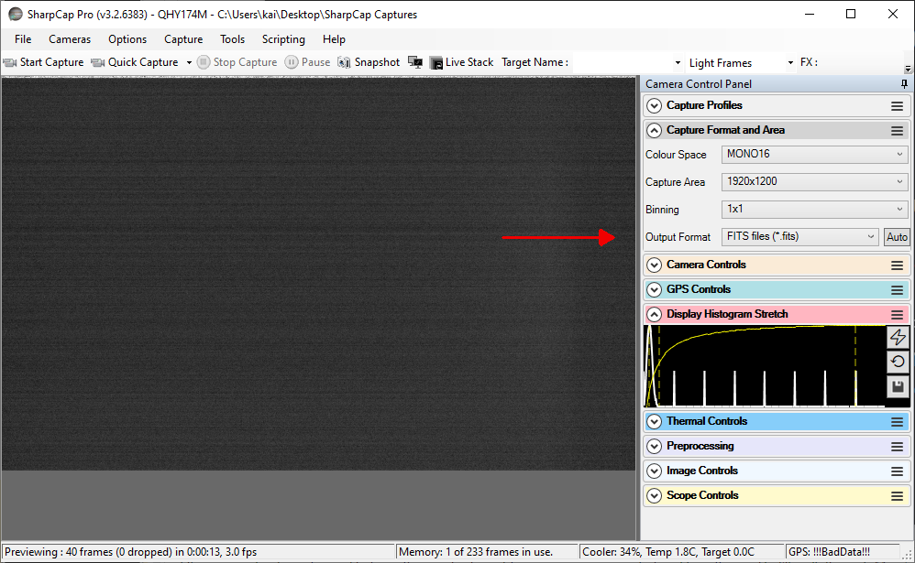
Notes:
...This last setting can be tricky to see. To me, especially in Night Vision mode, it’s unclear when the Auto button, on the far right here, is enabled for Output Format. Can you tell? Slightly grayer than the other controls, so looks like it’s on? -- but no, actually it’s not. The way to be sure is to pull the format select box down...

Slide 18
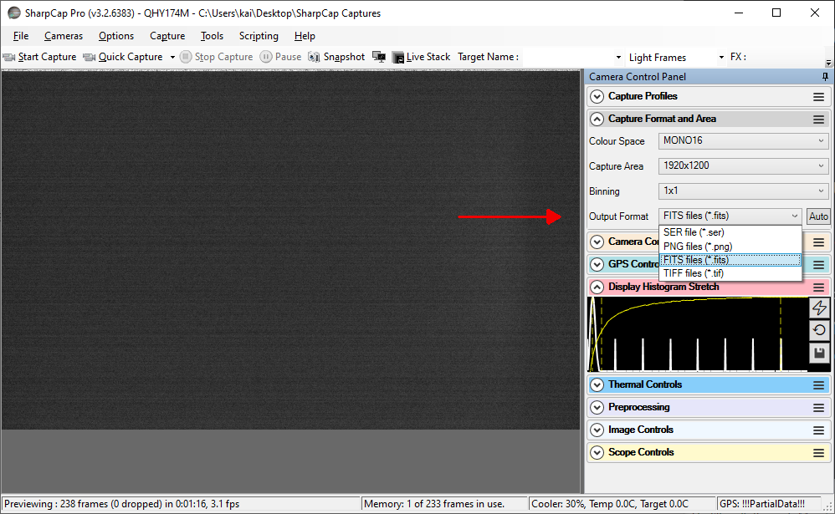
Notes:
…if that select box is active/selectable, then Auto is off/disabled, which is what we want.

Slide 19
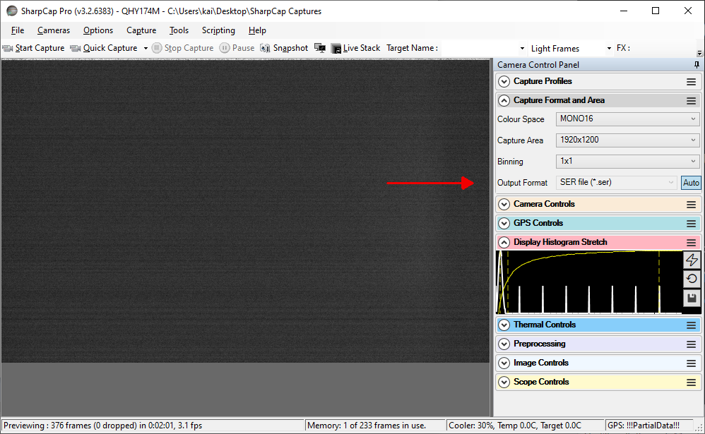
Notes:
If Auto is enabled, then we can’t select from the Output Format box. Here we can tell Auto is enabled, cause it shows in blue -- but it’s not always obvious as I said, especially in night vision mode. Confirm by ensuring the select box is active, and thus Auto is off.

Slide 20
Best practices -- Profile settings -- Camera Controls
Exposure: varies, e.g. 500ms LX Mode: off
Quick Picks: none Auto: off
Gain: 300
Reduces read noise; >300 just loses more dynamic range
Frame Rate Limit: maximum
Amp Noise Reduction: on Auto: off [same GUI issue as Output Format Auto]
Offset: 100
Avoids clipping blacks, better idea of background levels
USB Traffic: 50
Your mileage may vary
Enable Live Broadcast: off
Force Still Mode: off
Notes:
Ok on to the next set of profile settings -- Camera Controls. Exposure varies of course; LX Mode off, no Quick Picks and auto off. Gain: Marc likes to use 300: this reduces read noise, and beyond 300 seems to havel little further improvement, but just loses more dynamic range. Frame Rate Limit to maximum, Amp Noise Reduction on with Auto off -- note same GUI issue as Output Format Auto -- hard to see the status of that Auto button. Offset to 100 to avoid clipping blacks; makes the background levels easier to judge. USB Traffic to 50; this might help reduce dropped frames and/or high frame rates; I have rarely found it to affect either, but your mileage may vary. Enable Live Broadcast off, and Force Still Mode off; we don’t use those.

Slide 21
Best practices -- Profile settings -- GPS Controls
GPS: on [Show Data just pops up possibly-hidden GPS Status window]
GPS Calibration LED: off
Calibration Start Pos: 0 [in 3.2.6194? and earlier, else calibrate]
Calibration End Pos: 1000 [in 3.2.6194? and earlier, else calibrate]
Notes:
Now to GPS Controls: GPS should be on of course; the Show Data button is not a setting, it just pops up the possibly-hidden GPS Status window so you can see it. GPS Calibration LED should be off since a saved profile should already be calibrated. Start Pos to 0 if you use 3.2.6194 and earlier and/or have no BadCal issues, otherwise calibrate. End Pos to 1000, and ditto.

Slide 22
Best practices -- Profile settings -- Image Controls
Gamma: 1.0
Brightness: 0.0
Contrast: 0.0
Timestamp frames: off
Altering any of these will change/lose capture data; leave set to these defaults
Notes:
Image Controls: basically, don’t touch anything here. Gamma 1, Brightness 0, Contrast 0, Timestamps off. Touching any of these will change or lose capture data, as we’ve seen; leave them set to defaults.

Slide 23
Best practices -- Profile settings -- Thermal Controls
Cooler Power: Auto
Lets software manage it
Target Temperature: 0
Cooler chip means less hot pixels
Notes:
Thermal Controls: Cooler Power to auto so software will manage it for us; Target Temperature 0, since a cooler chip means fewer hot pixels.

Slide 24
Best practices -- Profile settings -- Preprocessing
Subtract Dark: none
Apply Flat: none
Banding Suppression: 0
Notes:
Preprocessing: these are all off, we don’t want to alter the capture data, we’re not taking pretty pictures.

Slide 25
Best practices -- Profile settings -- Display Histogram
Set as desired when viewing -- has no effect on capture data
Notes:
Display Histogram Stretch: play with this as much as you want to make stuff viewable, it has no effect on capture data, only the live display.

Slide 26
Best practices: File -> SharpCap Settings -> General
Automatically connect to camera when SharpCap starts: on
Automatically restore camera settings: on
Save capture settings file alongside each capture: on
May be useful for analysis
Start cameras with ‘Auto’ output format: off
More whack-a-mole to prevent output format changing on us
Save 10/12/14 bit images in FITS files without scaling: off
Preferred still format: FITS
Record information in the log: off
Log all QHY GPS data to file: on
Helps forensics: finding if/when almanac/leap seconds applied
Notes:
And that’s it for profile settings. But we’ll have one more slide of global settings. These are set in File -> SharpCap Settings -> General. Automatically connect to camera when SharpCap starts: on. Automatically restore camera settings: on. Save capture settings file alongside each capture: on. This saves the camera settings used at the time of a capture to a text file, alongside the capture data. It can be be useful for analysis later. Start cameras with ‘Auto’ output format: off. More whack-a-mole to prevent output format changing on us. Save 10/12/14 bit images in FITS files without scaling: off. Preferred still format: FITS. Record information in the log: off. Log all QHY GPS data to file: on. This can be very useful for later forensics, for example finding if/when the GPS almanac was downloaded and leap seconds applied.

Slide 27
Best practices -- In the field
Try to ensure GPS almanac is downloaded (leap seconds applied)
Wait ~20 minutes with GPS Locked: almanac can take 12.5 minutes to download
Or:
When first GPS locked: `Set PC Time to GPS Time’
Watch `Sys clock NNN.N ahead/behind of GPS’
When it goes from ~0 to +/- ~2-3, leap seconds probably applied, almanac downloaded
`Set PC Time to GPS Time’ again, time synced
Do test capture before event, look for dropped frames
After event, check GPS time with another source: WWV, Naval Obs.
Notes:
Ok, so enough of settings! Second to last slide: On to some best practices in the field. Try to ensure the GPS almanac has been downloaded before taking data. As we saw, even with the firmware update, there’s no direct indication in the GUI that this has happened One way is to simply wait 20 minutes with the GPS Locked, since the almanac should take about 12 and a half minutes to download with a continuous GPS lock. Or, another, slightly more visible way: do the following: sync the PC time to GPS right when you first get a lock. This will make the system/GPS time difference shown in the GPS window just about 0. Then watch that difference: if/when it goes to like 2 or 3 seconds, that probably indicates leap seconds are now being applied, and thus the almanac has finished. At that point, sync the time again, and you should be good to go. Other good ideas: do a test capture before the event to see that everything works, look for dropped frames. And after the event, maybe check the GPS time with another source, as a sanity check that you’re not off by several seconds.

Slide 28
References / Resources
2020-06-28 Zoom meeting -- thanks to all attendees for input
SharpCap forums
Post on firmware upgrading
YouTube: Lucy Mission channel
SharpCap Configuration
Notes:
Finally, some resources.
As I mentioned at the start, the June 28 Zoom meeting that George organized was immensely helpful; thanks to all attendees for your input -- Rick Bria, Dr. Marc Buie, David & Joan Dunham, Kevin Green, Bill Hanna, Roxanne Kamin, Bob Meadows, John Moore, Ned Smith, and George Viscome. I believe George can share the link for a video of the meeting if you contact him.
The SharpCap forums have a lot of useful info, and there is a thread there with some info on how to upgrade the QHY firmware.
And finally, the Lucy Mission has posted a number of videos on YouTube, including a walkthrough of the SharpCap settings they use with these cameras, which I based my settings slides on. Look for “SharpCap Configuration” by the Lucy Mission.
Thanks!

